Slide 1
Occupational Health Center and Travel Medicine Program
Margaret Stroz, MD, MRO
Medical Director

Slide 2
Why should an employer choose an occupational health center?
5 Good Reasons for Choosing Occupational Health
Or
What can we offer that’s different!

Slide 3

ACOEM Affiliation
ACOEM Vision: ACOEM is the pre-eminent organization of physicians who champion the health and safety of workers, workplaces, and environments.
OEM Mission: Occupational and environmental medicine is the medicine specialty devoted to prevention and management of occupational and environmental injury, illness and disability, and promotion of health and productivity of workers, their families, and communities.
ACOEM, an international society of 5,000 occupational physicians, provides leadership to promote optimal health and safety of workers, workplaces, and environments

Slide 4
Physical Exams and Work Clearances
  Pre-placement Evaluations
  Functional Capacity Evaluations
  Fitness for Duty Evaluations
  Regulated Exams
  FMCSA/DOT
  OSHA Surveillance and
  Respirator Clearance

Slide 5
Worker’s Compensation Injury Care
ACOEM Guidelines
SAW/RTW/Transitional
Focus toward Function not Disability
Communication

Slide 6
Odds of Ever Returning to Work
Fall Rapidly Over Time
Notes:
This graph, which is based on unpublished data from a workers’ compensation insurance population, shows that the chance of ever returning to work drops to less than 50% once time off work reaches 12 weeks. Those who go onto Social Security Disability Insurance have an extremely low chance of ever returning to work, between a half of one percent and about 3%, according to Mathematica Policy Research. This suggests that there is some need for urgency in return to work planning if it is to be successful.

Slide 7
BARRIERS TO WORK
Tendency to let Severity of Injury
employee determine Comorbid conditions
work disposition
Rx inactivity only when No Modified duty
medically required
Unfamiliar with Employer/ee
modified/transitional/ Friction
recovery on the job
Work Options
Fear Fraud
Catastrophizing Legal
Disabled Planning
Feeling Mistreated not to RTW
Medical
Factors
Physician
Practice
Barriers
Job
RTW Barriers
Employee
Benefits,
Fears,
Attitudes
Other
Agendas

Slide 8

SPICE MODEL
Simplicity: Simple benign conditions treated in a complicated fashion become complicated
Proximity: Benefit of keeping injured worker connected to work place.
Immediacy: Acute injuries dealt with in a timely manner.
Benefit of early intervention.
Centrality: All parties common philosophy and ultimate goal of RTW.
Expectancy: Individuals often fulfill expectations placed upon them.
US Military’s 1973 Forward Treatment Method that prevents system-induced disability among battle causalities, returning 60% of soldiers with injuries to full duty within 72 hrs.

Slide 9
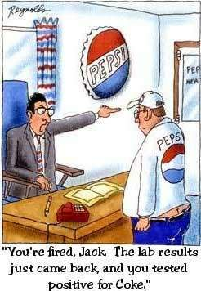
Alcohol and Drug Screen Testing

Slide 10
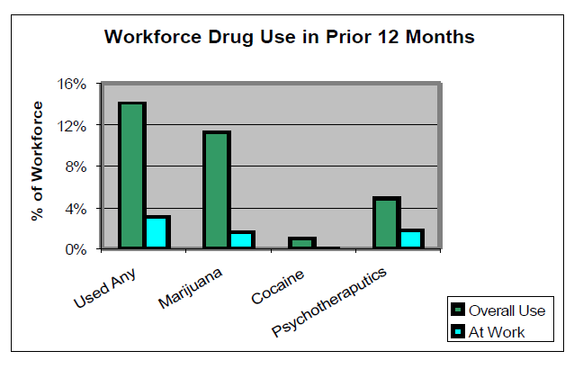
2006 Workplace Substance Use
Overall Use
At Least One Illicit Drug: 14.1% (17.7M workers)
Marijuana: 11.3% (14.2M workers)
Cocaine: 1.0% (1.3M workers)
Psychotherapeutic Drugs: 4.9% (6.2M workers)
At work
3.1% (3.9M workers)
1.6% (2M workers)
0.1% (169,000 workers)
1.8% (2.3M workers)
Journal of Applied Psychology. 2008, Vol. 91, No. 4, 856-869

Slide 11

Substance Abuse in the Workplace Is a Widespread Problem
According to the 2006 National Survey on Drug Use and Health, 74.9 percent of all adult illicit drug users are employed full or part time
www.samhsa.gov/sites/default/files/workplace-kit.pdf

Slide 12
Substance Abuse in the Workplace Can Have Serious Consequences
Substance abusing employees often do not make good employees. They are more likely to….
  To change jobs frequently (2xs)
  To be late to or absent from work (2x/mo)
  To be less productive employees (33%)
  To be involved in a workplace accident (3.5xs)
  To file a workers’ compensation claim (5xs)
Notes:
Twice as likely to change jobs >3xs/yr
Absent or ill 2xs/month
33% less productivity
3.5Xs more likely to be involved in a work related accident 5xs more likely to file a WC claim

Slide 13
Urine Drug Screen Testing
MRO Drug Screen Result Verification

Slide 14
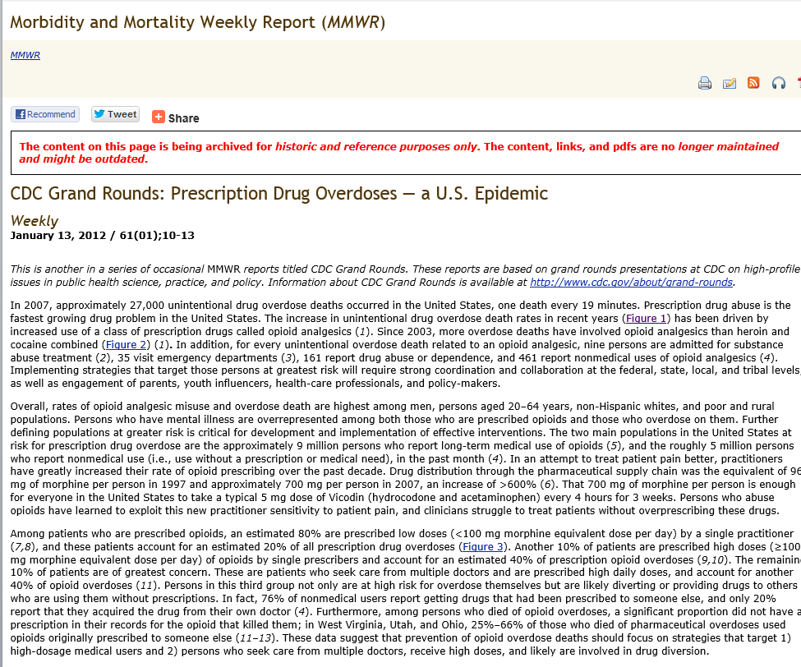

Slide 15
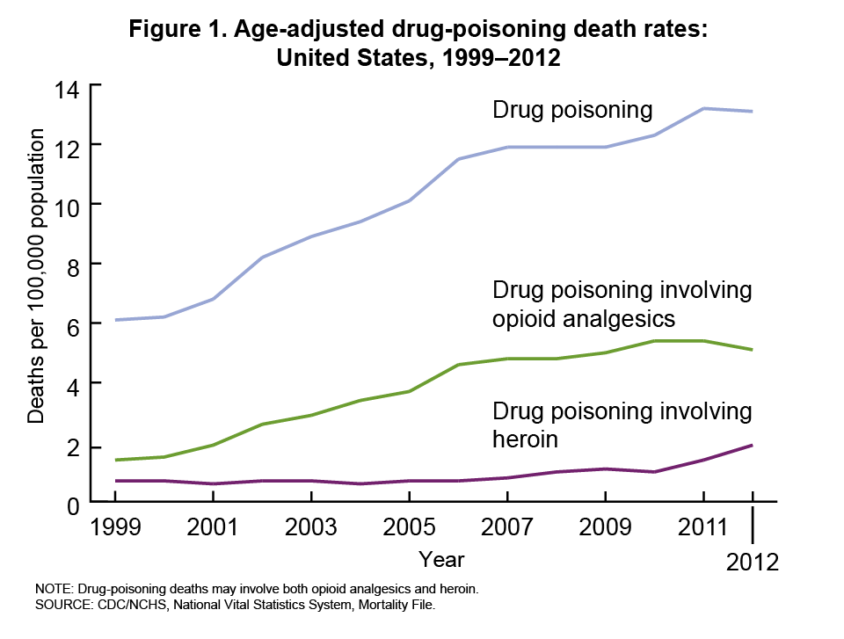
Notes:
The figure above shows the number of unintentional drug overdose deaths involving opioid analgesics, cocaine, and heroin in the United States during 1999–2007. Since 2003, more overdose deaths have involved opioid analgesics than heroin and cocaine combined.

Slide 16
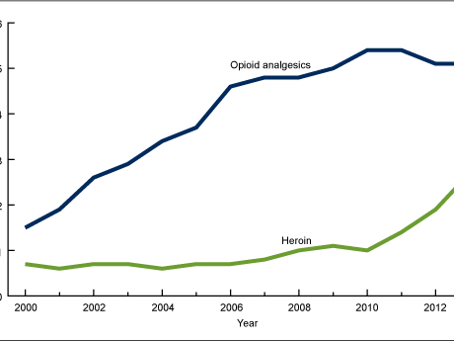
Age-adjusted rates for drug-poisoning deaths, by type of drug: United States, 2000–2013
While the age-adjusted rate for drug-poisoning deaths involving opioid analgesics has leveled in recent years, the rate for deaths involving heroin has almost tripled since 2010.

Slide 17


Travel Medicine Program
A bonus!
For business or vacation international travel

